Slide 1
Living or Non-Living?

Slide 2
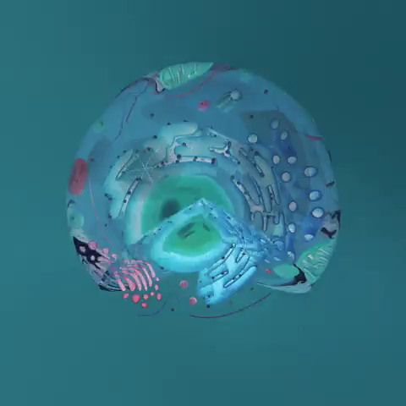
By the end of the lesson, you should be able to:
1. | Explain "living" based on the cell theory.
2. | Explain unicellular and multicellular.

Slide 3
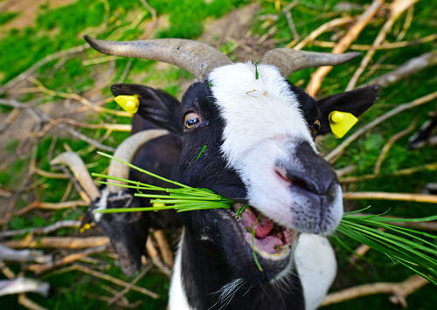
As you look around you, you probably have some idea of which things are living and which things are non-living.
How do you know this? Have you ever thought about what it means for something to be alive?

Slide 4
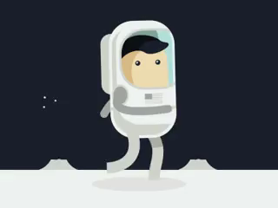
Classifying things as being alive or not is important for humans to make sense of our place in the Universe.
Some scientists are trying to find evidence that life exists on planets other than Earth.
How are they going to determine whether anything they find is "alive" or not?

Slide 5
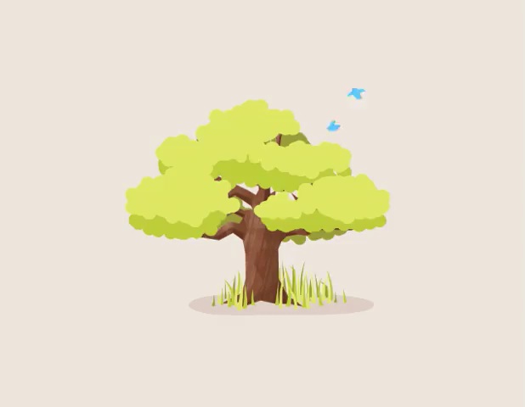
Defining life is extremely difficult.
This is why we need a classification system for determining whether something is living or non-living based on its observable characteristics.
What are some features of living things around you that you use to distinguish them from non-living things?

Slide 6
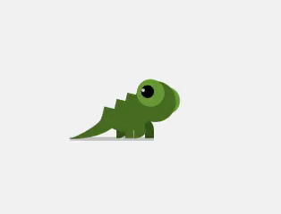
The ancient Greek philosopher Aristotle (384-322 BC) was one of the first to try to define life.
He based his work on the observable characteristics of things that he saw.
He said that something that grows, maintains itself, and reproduces can be considered alive.

Slide 7
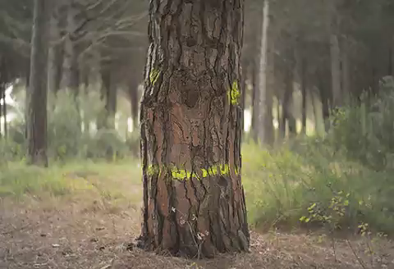
In 1665, a scientist called Robert Hooke was looking at a piece of cork under a microscope.
Cork is the outer layer of tree bark.
He noticed that the cork seemed to be made up of lots of little compartments, which he called cells.

Slide 8
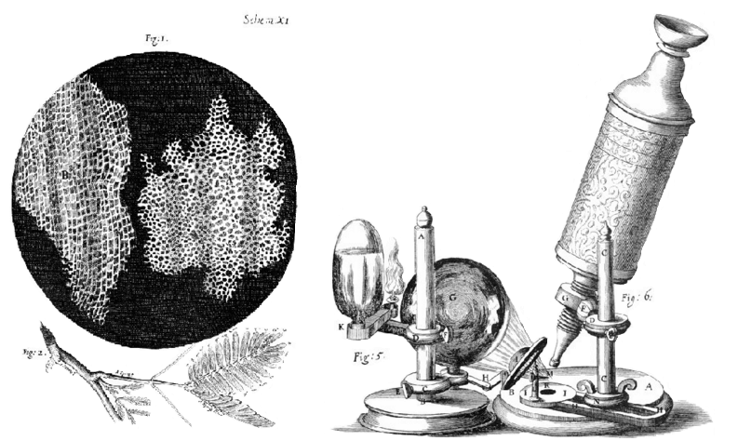
Cells had never been observed before because they are too small to see with the naked eye.
The smallest things you can see using just your eyes are about 100 micrometres long, so the cells needed to be magnified by at least 4 times before Hooke could see them.
The individual cork cells could not be seen without a microscope because they are only 25 micrometres long - that is, 0.000025 m!

Slide 9
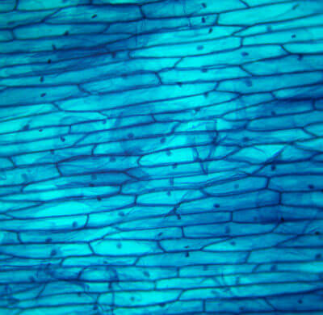
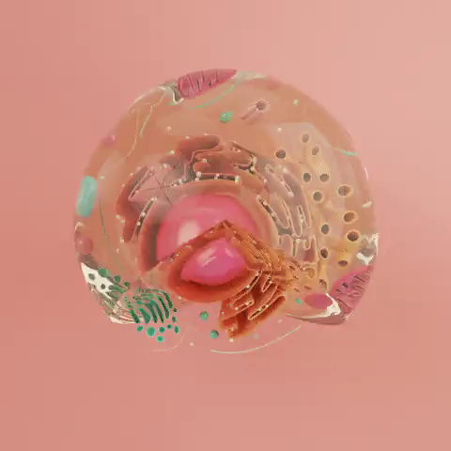
One important idea of Dr. Schwann and Dr. Schleiden's cell theory was that all living things are made of cells.
Anything that is alive is made up of at least one cell, so if something is not made up of cells, it is not alive!

Slide 10
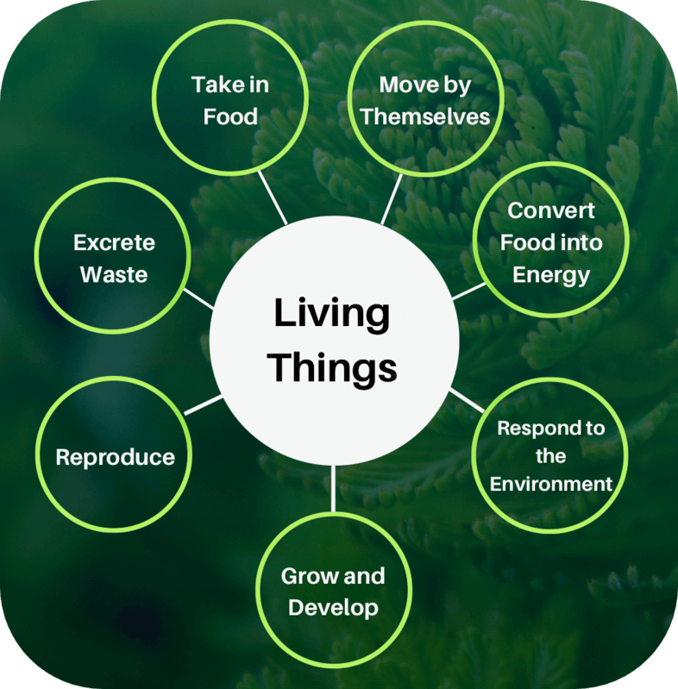
Cells can be defined as "the smallest building blocks of life."
This means that a cell is the smallest unit of matter that can carry out all of the life processes that scientists now use to define something as alive.
You will learn more about these specific life processes in the next Smart Lesson. These life processes are:

Slide 11
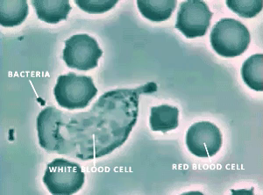
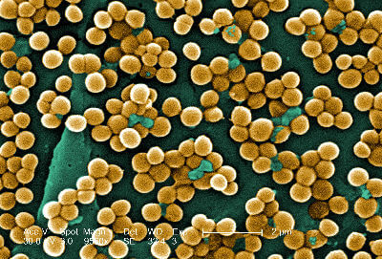
Living things can be made up of one cell or many cells.
Unicellular organisms are those made up of only one cell. "Uni" comes from the Latin term for "one".
Bacteria are examples of unicellular organisms.
21 of 34
Processing...
Home
Invite a teacher

Slide 12
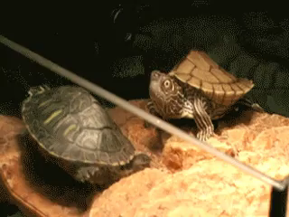
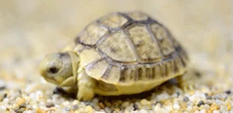
Multicellular organisms are those made up of more than one cell.
"Multi" comes from the Latin term for "many".
Tortoises are examples of multicellular organisms.

